Slide 1
Dep 202 data analysis cosmopolitan university
DATA ANALYSIS ASSIGNMENT ON EMPLOYEE PERFORMANCE
Emmanuel Omoefe Odafe
25A-SCT-CYB-0282

Slide 2
Business Objective (PROBLEM STATEMENT)
You have been hired as a Data Analyst by a company to review their employee performance data.
Analysis Questions
What is the highest Monthly Salary in the dataset?
What is the lowest Monthly Salary recorded in the dataset?
Which Department has the highest total Performance Score?
How many employees work in each Work Location (Abuja, Lagos, Remote)?
Which Job Level (Junior, Mid-Level, Senior) has the highest total salary paid?

Slide 3


What are the highest and lowest monthly salaries
The Highest Monthly Salary is 838877.7
The Lowest Monthly Salary is 0

Slide 4
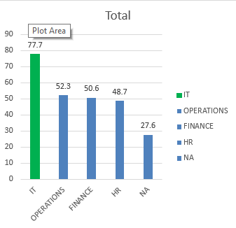
Which department has the highest total performance score
The department with the highest total performance score is the IT department having a score of 77.7

Slide 5
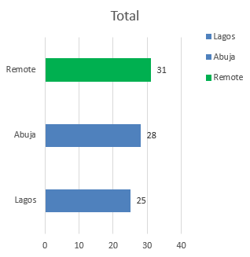
How many employees work in each location
31employees working remotely
28 employees working in Abuja
25 employees working in Lagos

Slide 6
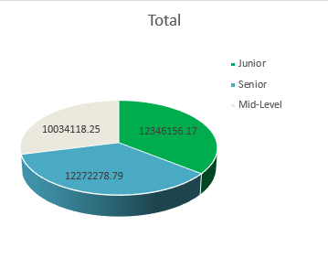
Which job level has the highest total salary paid
Junior Level with 12346156.17 has the highest total salary paid.

Slide 7
recommendations
Audit and replace all "NA" and "0" placeholders in employee records with accurate, verified data across the Department, Monthly Salary, and Performance Score fields.
Design and deliver targeted training and feedback initiatives for the HR Department to bridge performance gaps and strengthen overall team effectiveness

Slide 8
Thank you for Your time

